Slide 1
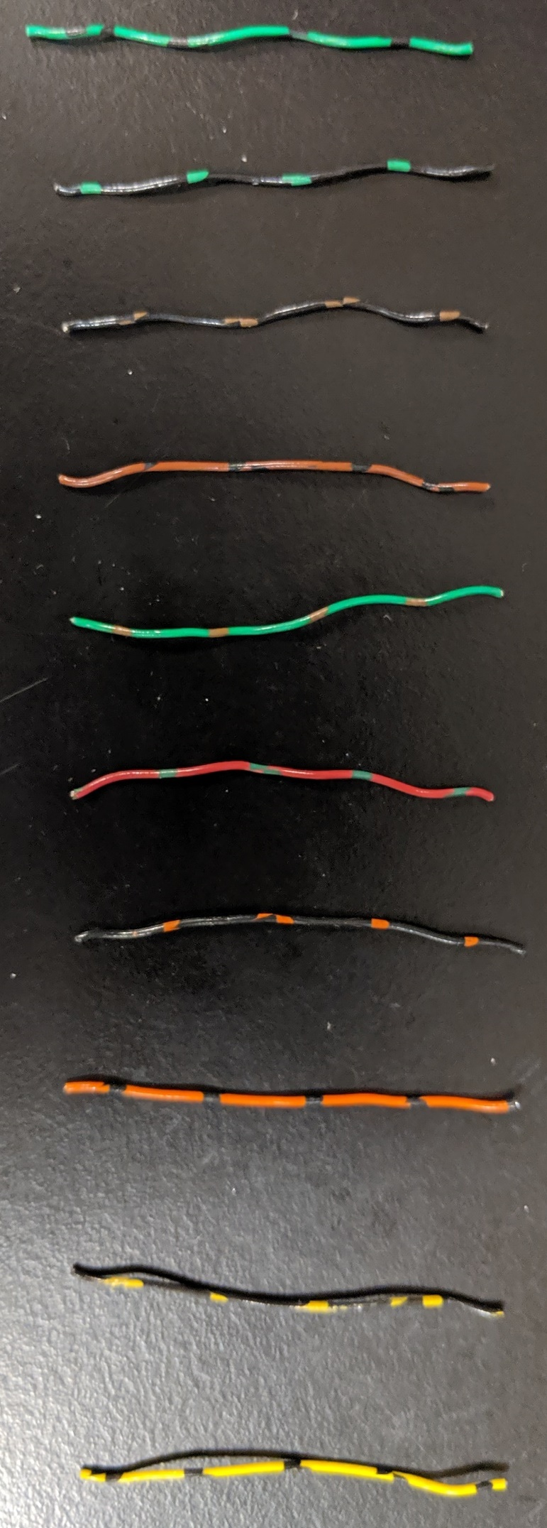
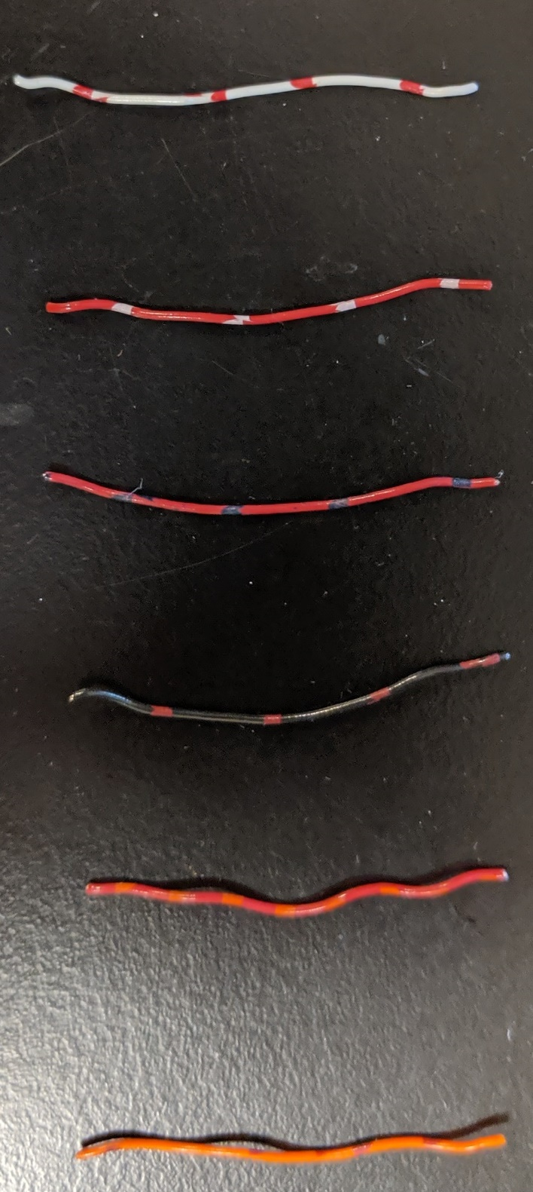
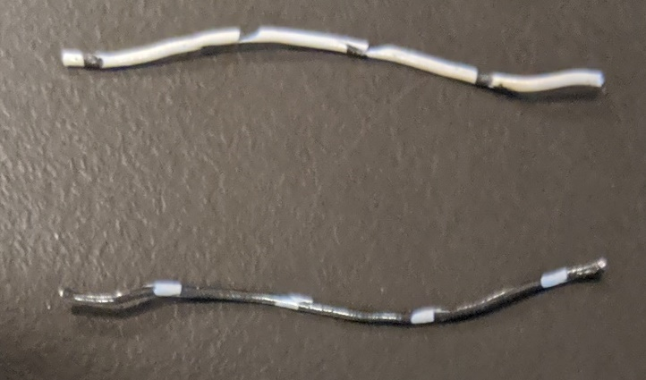
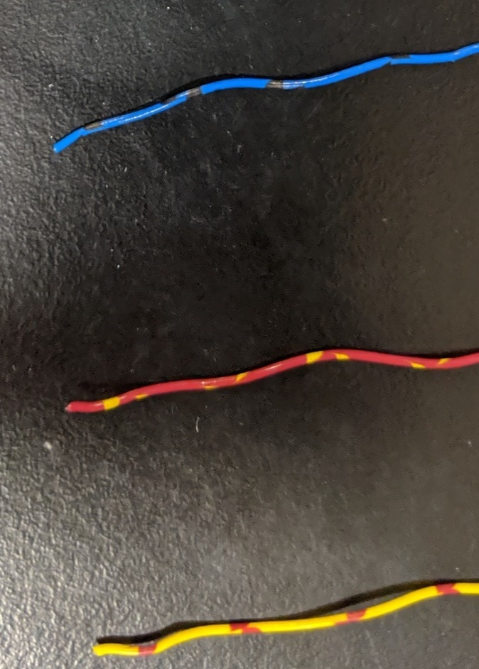
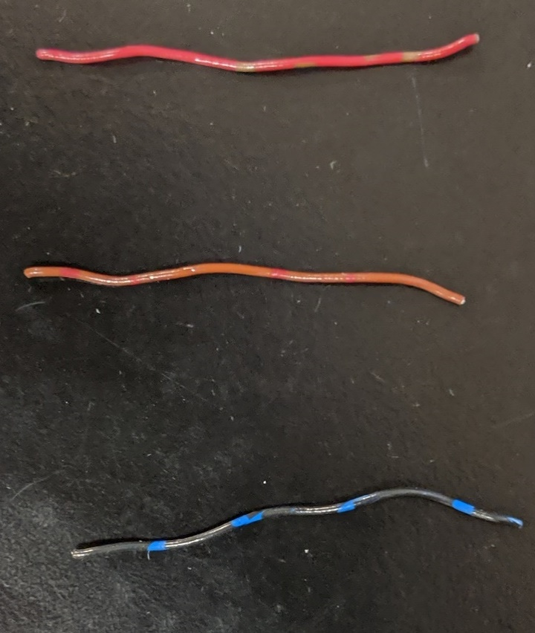
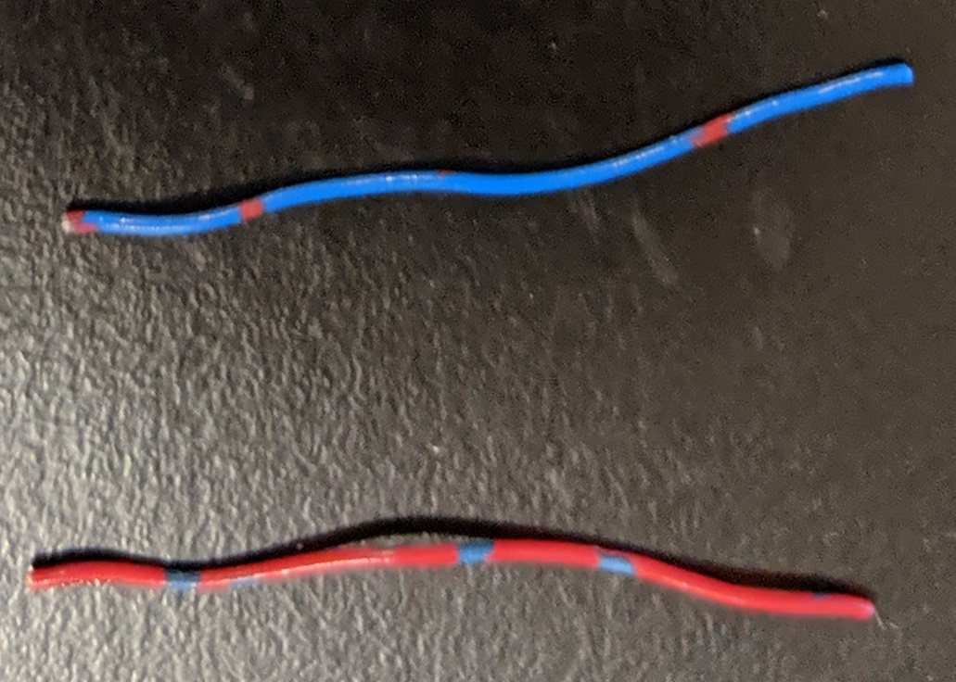
Fisher to Breakout box cable wire assignment
Green/Black 1
Black/Brown 3
Green/Red 5
Black/Orange 7
Black/Yellow 9
Black/Green 2
Brown/Black 4
Red/Green 6
Orange/Black 8
Yellow/Black 10
White/Black 11
White/Red 13
Red/Black 15
Black/Red 16
Red/Orange 17
Black/White 12
Red/White 14
Orange/Red 18
Red/Brown 19
Black/Blue 21
Red/Yellow 23
Blue/Red
Red/Blue
Brown/Red 20
Blue/Black 22
Yellow/Red 24
Unused

Slide 2
How resistance values are measured
Blue: custom attocube cables
Purple: custom D-SUB to Fischer cables
DVM
(USED TO MEASURE RESISTANCE VALUE)
Fischer
Top of Fridge
Breakout Box
DVM
(USED TO MEASURE RESISTANCE VALUE)
Glenair
BNC plugs
BNC cable
MC plate

Slide 3
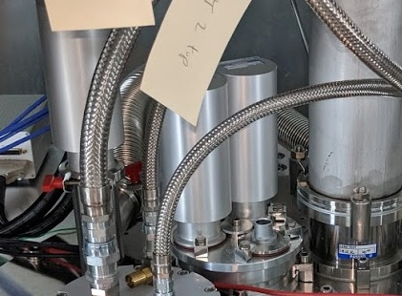
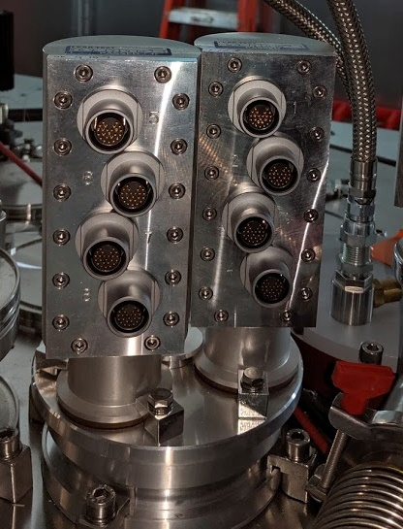
DC Line Resistances from Glenair on MC plate to either breakout box BNC plugs (Loom 5 and 6) or end of attocube cables (special loom) (Hence, the resistance values include the wires made)
Loom 5 | R (ohms) | Loom 6 | R (ohms) | Loom Special | R (ohms)
1 | 22 | 25 | 22 | 1 | 4
2 | 22 | 26 | 21 | 2 | 4
3 | 22 | 27 | 22 | 3 | 4
4 | 21 | 28 | 21 | 4 | 4
5 | 22 | 29 | 22 | 5 | 4
6 | 21 | 30 | 21 | 6 | 4
7 | 22 | 31 | 22 | 7 | NC
8 | 21 | 32 | 22 | 8 | 13
9 | 22 | 33 | 22 | 9 | 14
10 | 21 | 34 | 21 | 10 | 13
11 | 22 | 35 | 22 | 11 | 14
12 | 21 | 36 | 21 | 12 | 13
13 | 22 | 37 | 22 | 13 | 14
14 | 21 | 38 | 21 | 14 | 13
15 | 22 | 39 | 22 | 15 | 14
16 | 21 | 40 | 21 | 16 | 13
17 | 22 | 41 | 22 | 17 | 14
18 | 20 | 42 | 21 | 18 | 13
19 | 22 | 43 | 22 | 19 | 14
20 | 21 | 44 | 21 | 20 | 13
21 | 22 | 45 | 22 | 21 | 14
22 | 20 | 46 | 21 | 22 | 13
23 | 22 | 47 | 22
24 | 21 | 48 | 21
Special low resistance loom
1
5
2
6
3
7
4
8
Fisher 5 and 6 used.

Slide 4
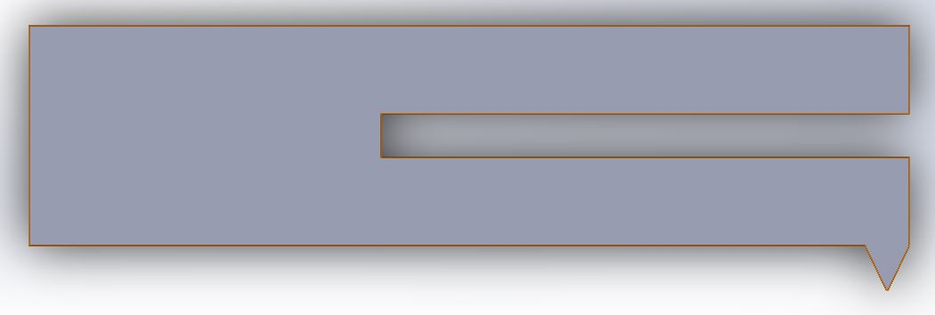
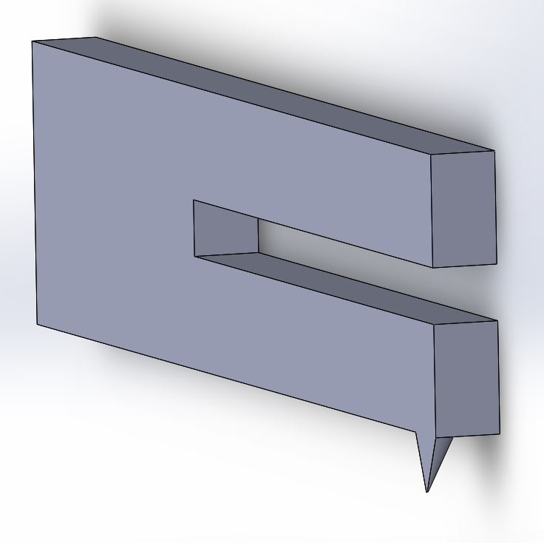

5.84mm
0.58mm
1.49mm
0.33mm
0.58mm
The sharper the tip, the better
500nm diameter (not drawn to scale)
5um
We need the side of the tuning fork and the side of the tip to be flat. (embedded in the same plane)

